Slide 1
P, NP, NP-Hard & NP-complete problems
Lecture 4a

Slide 2
Objectives
P, NP, NP-Hard and NP-Complete
Solving 3-CNF Sat problem

Slide 3
Types of Problems
Trackable
Intrackable
Decision
Optimization
Trackable : Problems that can be solvable in a reasonable(polynomial) time.
Intrackable : Some problems are intractable, as they grow large, we are unable to solve them in reasonable time.

Slide 4
Tractability
What constitutes reasonable time?
  Standard working definition: polynomial time
  On an input of size n the worst-case running time is O(n^{k}) for some constant k
– O(n²), O(n³), O(1), O(n lg n), O(2^{n}), O(n^{n}), O(n!)
  Polynomial time: O(n²), O(n³), O(1), O(n lg n)
  Not in polynomial time: O(2^{n}), O(n^{n}), O(n!)
Are all problems solvable in polynomial time?
  No: Turing’s “Halting Problem” is not solvable by any computer, no matter how much time is given.

Slide 5
Optimization/Decision Problems
Optimization Problems
  An optimization problem is one which asks, “What is the optimal solution to problem X?”
  Examples:
    0-1 Knapsack
    Fractional Knapsack
    Minimum Spanning Tree
Decision Problems
  An decision problem is one with yes/no answer
  Examples:
    Does a graph G have a MST of weight less than W?

Slide 6
Optimization/Decision Problems
An optimization problem tries to find an optimal solution
A decision problem tries to answer a yes/no question
Many problems will have decision and optimization versions
  Eg: Traveling salesman problem
    optimization: find hamiltonian cycle of minimum weight
    decision: is there a hamiltonian cycle of weight less than k

Slide 7
P, NP, NP-Hard, NP-Complete
-Definitions

Slide 8
The Class P
P: the class of problems that have polynomial-time deterministic algorithms.
That is, they are solvable in O(p(n)), where p(n) is a polynomial on n
A deterministic algorithm is (essentially) one that always computes the correct answer

Slide 9
Sample Problems in P
Fractional Knapsack
MST
Sorting
Others?

Slide 10
The class NP
NP: the class of decision problems that are solvable in polynomial time on a nondeterministic machine (or with a nondeterministic algorithm)
(A determinstic computer is what we know)
A nondeterministic computer is one that can “guess” the right answer or solution
Think of a nondeterministic computer as a parallel machine that can freely spawn an infinite number of processes
Thus NP can also be thought of as the class of problems “whose solutions can be verified in polynomial time”
Note that NP stands for “Nondeterministic Polynomial-time”

Slide 11
Sample Problems in NP
Fractional Knapsack
MST
Others?
  Traveling Salesman
  Graph Coloring
  Satisfiability (SAT)
    the problem of deciding whether a given Boolean formula is satisfiable

Slide 12
P And NP Summary
P = set of problems that can be solved in polynomial time
  Examples: Fractional Knapsack, …
NP = set of problems for which a solution can be verified in polynomial time
  Examples: Fractional Knapsack,…, TSP, CNF SAT, 3-CNF SAT
Clearly P ≠ NP
Open question: Does P = NP?
  P ≠ NP

Slide 13
NP-hard
What does NP-hard mean?
– A lot of times you can solve a problem by reducing it to a different problem. I can reduce Problem B to Problem A if, given a solution to Problem A, I can easily construct a solution to Problem B. (In this case, "easily" means "in polynomial time.“).
A problem is NP-hard if all problems in NP are polynomial time reducible to it, ...
Ex:- Hamiltonian Cycle
Every problem in NP is reducible to HC in polynomial time. Ex:- TSP is reducible to
HC.
B
A
Example: lcm(m, n) = m * n / gcd(m, n),
13

Slide 14
NP-complete problems
A problem is NP-complete if the problem is both
  NP-hard, and
  NP.

Slide 15
Reduction
A problem R can be reduced to another problem Q if any instance of R can be rephrased to an instance of Q, the solution to which provides a solution to the instance of R
– This rephrasing is called a transformation
Intuitively: If R reduces in polynomial time to Q, R is “no harder to solve” than Q
Example: lcm(m, n) = m * n / gcd(m, n),
lcm(m,n) problem is reduced to gcd(m, n) problem

Slide 16
NP-Hard and NP-Complete
If R is polynomial-time reducible to Q, we denote this R ≤_{p} Q
Definition of NP-Hard and NP- Complete:
  If all problems R Є NP are polynomial-time
reducible to Q, then Q is NP-Hard
  We say Q is NP-Complete if Q is NP-Hard and Q Є NP
If R ≤_{p} Q and R is NP-Hard, Q is also NP-Hard

Slide 17
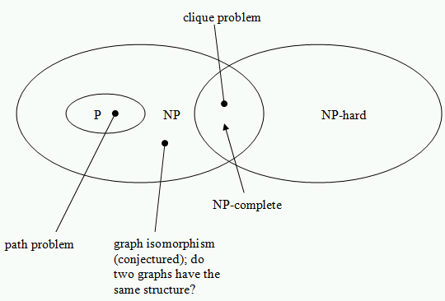

Slide 18
Summary
P is set of problems that can be solved by a deterministic Turing machine in Polynomial time.
NP is set of problems that can be solved by a Non-deterministic Turing Machine in Polynomial time. P is subset of NP (any problem that can be solved by deterministic machine in polynomial time can also be solved by non-deterministic machine in polynomial time) but P≠NP.

Slide 19
Some problems can be translated into one another in such a way that a fast solution to one problem would automatically give us a fast solution to the other.
There are some problems that every single
problem in NP can be translated into, and a fast solution to such a problem would automatically
give us a fast solution to every problem in NP. This group of problems are known as NP- Complete. Ex:- Clique
A problem is NP-hard if an algorithm for solving
it can be translated into one for solving any NP-
problem (nondeterministic polynomial time) problem. NP-hard therefore means "at least as hard as any NP-problem," although it might, in fact, be harder.

Slide 20
First NP-complete problem— Circuit Satisfiability (problem definition)
Boolean combinational circuit
  Boolean combinational elements, wired together
  Each element, inputs and outputs (binary)
  Limit the number of outputs to 1.
  Called logic gates: NOT gate, AND gate, OR gate.
  true table: giving the outputs for each setting of inputs
  true assignment: a set of boolean inputs.
  satisfying assignment: a true assignment causing the output to be 1.
20

Slide 21
Circuit Satisfiability Problem: definition
Circuit satisfying problem: given a boolean combinational circuit composed of AND, OR, and NOT, is it stisfiable?
CIRCUIT-SAT={<C>: C is a satisfiable boolean circuit}
Implication: in the area of computer-aided hardware optimization, if a subcircuit always produces 0, then the subcircuit can be replaced by a simpler subcircuit that omits all gates and just output a 0.
21

Slide 22
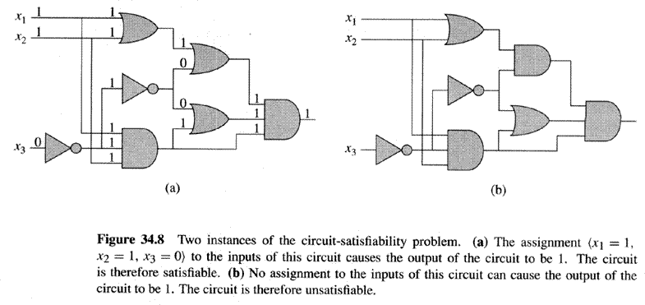
Two instances of circuit satisfiability problems
22

Slide 23
Solving circuit-satisfiability problem
Intuitive solution:
  for each possible assignment, check whether it generates 1.
  suppose the number of inputs is k, then the total possible assignments are 2^{k}.
So the running time is Ω(2^{k}). When the size of the problem is Θ(k), then the running time is not polynomial.
23

Slide 24
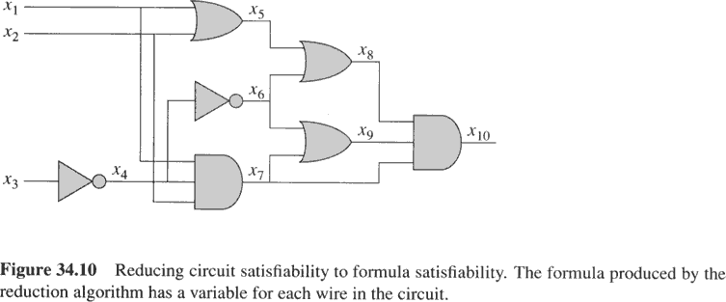
Example of reduction of CIRCUIT-SAT to SAT
= x₁₀(x₁₀(x₇ x₈ x₉))
(x₉(x₆  x₇))
(x₈(x₅  x₆))
(x₇(x₁ x₂ x₄))
(x₆ ➢x₄))
(x₅(x₁  x₂))
(x₄➢x₃)
REDUCTION: = x₁₀= x₇ x₈ x₉=(x₁ x₂ x₄)  (x₅  x₆) (x₆  x₇)
=(x₁ x₂ x₄)  ((x₁  x₂)  ➢x₄) (➢x₄  (x₁ x₂ x₄))=….
24

Slide 25
Conversion to 3 CNF
The result is that in φ’ each clause has at most three literals.
Change each clause into conjunctive normal form as follows:
  Construct a true table, (small, at most 8 by 4)
  Write the disjunctive normal form for all true-table items evaluating to 0
  Using DeMorgan law to change to CNF.
The resulting φ’’ is in CNF but each clause has 3 or less literals.
Change 1 or 2-literal clause into 3-literal clause as follows:
  If a clause has one literal l, change it to
  If a clause has two literals (l₁ v l₂), change it to

Slide 26
Thank You

